Slide 1
Automated Infrastructure Deployment
Using Terraform, AWS, Jenkins, and Ansible

Slide 2

Objective
Automate deployment of a secure, scalable, and reliable cloud infrastructure on AWS using Terraform, Jenkins, and Ansible
Key Points
Infrastructure supports web applications on EC2 instances.
Implements Infrastructure as Code (IaC) principles.

Slide 3
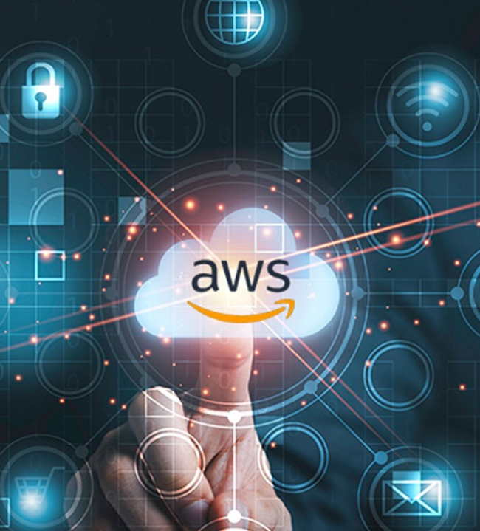
Architecture Overview
The architecture includes the following AWS resources:VPC: Custom with public and private subnets.
EC2 Instances: One public (bastion) and one private instance.
NAT Gateway: Secure access for private instances.
S3 Bucket: Stores Terraform state files.

Slide 4
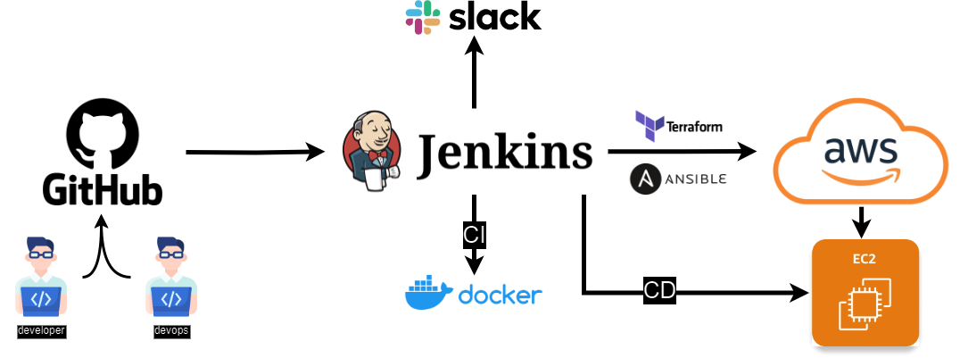
Architecture Diagram

Slide 5
Workflow Overview
Terraform deploys AWS resources.
Jenkins pipeline automates deployment.
Ansible configures EC2 instances.
Nginx reverse proxy setup for public acces

Slide 6
Key Challenges and Solutions
Securing private EC2 instances.
Implemented a bastion host to restrict access and used security groups for strict ingress/egress rules
Managing Terraform state files.
Stored state files in an S3 bucket with versioning for collaboration and state integrity.
Automating configuration on EC2 instances.
Integrated Ansible to automatically configure and manage software on the instances.

Slide 7
Project Outcomes
Fully automated and scalable cloud infrastructure.
Efficient CI/CD pipeline ensuring rapid deployment.
Secure and accessible setup with a reverse proxy.

Slide 8
Future Enhancements
Auto-scaling: Enable auto-scaling groups to handle traffic spikes automatically.
Monitoring and logging : integrate AWS CloudWatch and ELK stack for Realtime monitoring

Slide 9
SAAY Application Deployment

Slide 10
Objective
The objective of this project is to automate the deployment of a multi-tier application (frontend, backend, and database) using AWS infrastructure (EKS) and Jenkins as the CI/CD pipeline.
Key Steps
Fetch updates from GitHub.
Build Docker images and push them to Docker Hub.
Use Kubernetes deployments to manage services.

Slide 11
Introduction
This project demonstrates a complete CI/CD pipeline setup using AWS EKS, Jenkins, and Docker.
Goal: Simplify containerized application management by automating build and deployment processes.
Tools:
Terraform: Infrastructure as code to provision AWS resources.
EKS, Jenkins, Docker: Manage scalable infrastructure and deployment.

Slide 12
Project Scope
Creation and management of AWS infrastructure (VPC, Subnets, EKS Cluster).
Automated deployment and scaling of applications using Kubernetes.
CI/CD pipeline managed by Jenkins.
Docker for building and storing containers.
Securing Kubernetes cluster and AWS resources.

Slide 13
Architecture Overview
AWS VPC with two subnets (public and private).
EKS cluster for running containerized services.
Jenkins instance for managing the CI/CD pipeline, connected securely to EKS.

Slide 14
AWS Resources
VPC: Custom Virtual Private Cloud with public and private subnets.
EKS: Managed Kubernetes cluster.
Jenkins: Instance outside the VPC, securely connected to EKS.
S3 & IAM: State locking and role-based access control.

Slide 15
Security Overview
IAM roles and policies manage access to AWS resources.
Permissions for Jenkins and Ubuntu users to access EKS.
Docker images securely stored in Docker Hub.

Slide 16
Toolchain Overview
Terraform: Infrastructure as code for provisioning AWS resources.
Jenkins: CI/CD tool to fetch updates, build Docker images, and deploy using Kubernetes.
EKS: Manages frontend, backend, and database services.

Slide 17
Workflow
A GitHub commit or pull request triggers the Jenkins pipeline.
Jenkins builds Docker images for frontend, backend, and database.
Docker images are pushed to Docker Hub.
Jenkins applies Kubernetes manifests for deployment.
Jenkins handles scaling and updates of deployments.

Slide 18
Project Outcomes
Automated deployment process reduces manual intervention and speeds up deployment.
Infrastructure consistency through Terraform makes the environment easy to manage and reproduce.
Simplified build and push process using Docker and Jenkins.
Scalable architecture using Kubernetes for continuous delivery and application management.

Slide 19
Future Enhancements
Enable auto-scaling groups to handle traffic spikes automatically.
Improve security and monitoring of the Kubernetes cluster.

